Slide 1


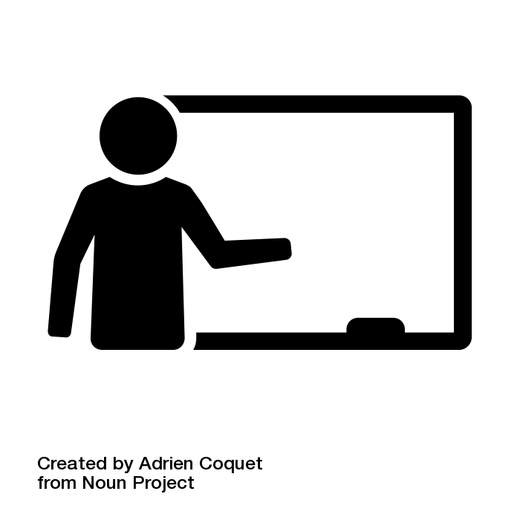


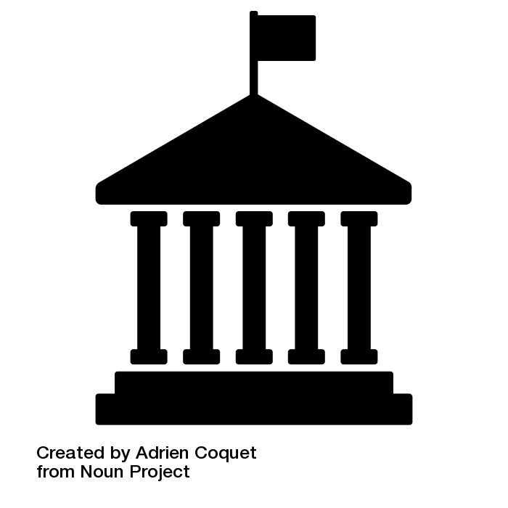




Voices from ABLE Members
ABLE builds more than just Buffalo’s students’ lives.
ABLE also builds the lives of community & ABLE members.
ABLE members believe:
“
“
I have learned much more about this community, myself, and my own impact on the lives of others around me.
- ABLE member
ABLE members build strong relationships.
Member Skill Growth
Career Plans
ABLE members:
Teacher
Empathy
Confidence & Leadership
Non-profit
Education
Policy-making
Communication
Social Work
“
92%
79%
“
I really leaned on my fellow ABLE members & we built a strong circle of friendship & camaraderie.
of members report increased understanding of the impact of poverty.
of members are more interested in working in high-need communities.
- ABLE member
For more information on ABLE or The Service Collaborative of WNY, visit http://www.tscwny.org.

